Slide 1
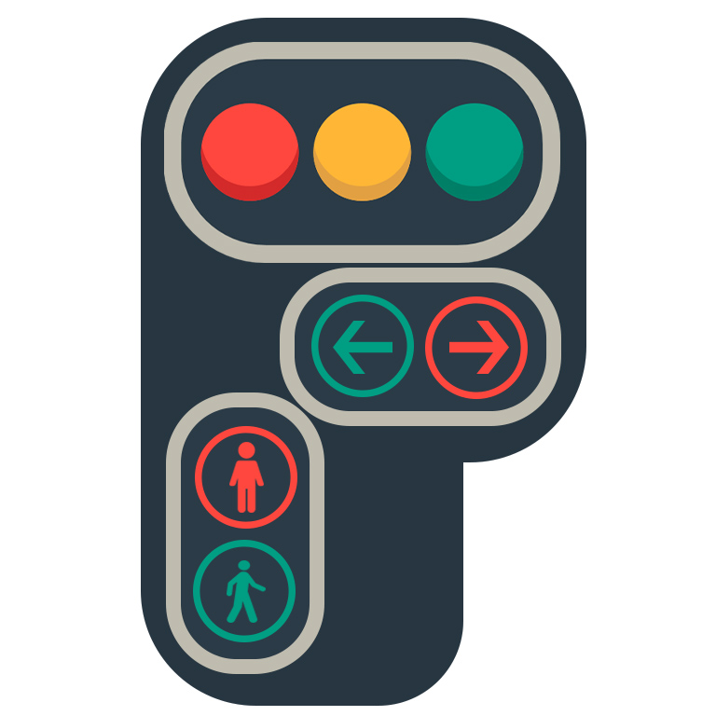
Iit bhu (Varanasi) EXPLORATORY PROJECT
Title –Density Based traffic control system using Arduino and Ultrasonic sensor
By- ABHishek kumar (20095002)
Dileep Gehlot (20095038)
Ritesh sahu (20095090)
Supervised by- professor dr. Satyabrata jit

Slide 2
Why this project ?
In today’s high-speed life, traffic congestion becomes a serious issue in our day-to-day activities. It brings down the productivity of individual and thereby the society as lots of work hour is wasted in the signals. High volume of vehicles, the inadequate infrastructure and the irrational distribution of the signaling system are main reasons for these chaotic congestions. It indirectly also adds to the increase in pollution level as engines remain on in most cases, a huge volume of natural resources in forms of petrol and diesel is consumed without any fruitful outcome. Therefore, in order to get rid of these problems or at least reduce them to significant level, newer schemes need to be implemented by bringing in sensor-based automation technique in this field of traffic signaling system.

Slide 3
introduction
Our project aims at reducing traffic congestion and unwanted long-time delay during the traffic light switch overs especially when the traffic is very low. It is designed to be implemented in places nearing the junctions where the traffic signals are placed, in order to reduce the congestion in these junctions. It keeps a track of the vehicles in each road and accordingly adjusts the time for each traffic light signals. The higher the number of vehicles on the road the longer will be the time delay allotted for that corresponding traffic light signal. The main purpose of this project is, if there will be no traffic on the other signal, one shouldn’t wait for that signal. The system will skip that signal and will move on the next one.

Slide 4
Block diagram
Power supply
Ultrasonic Sensor
Arduino Mega 2560
LED(RED, GREEN, YELLOW)

Slide 5
List of components
Arduino Mega 2560 --1
Ultrasonic sensor --1
Traffic Lights --8
LEDs-
i)Red
ii)green
iii)Yellow
Resistor (10k, 3w) --1
Pot-Hg --1 (high granularity interactive potentiometer)
Connecting wires

Slide 6
Project explANation
The model works on the principle of changing of Traffic signals based on the density through an assigned section of the road. There is one Ultrasonic sensor placed at the centre of crossroad which rotates 360 degree and checks the density of the 4 lanes area covered by the sensors. Here we are using Ultrasonic sensor to design an intelligent traffic control system. In order to measure the density of traffic on each side, Ultrasonic sensor will be kept at the centre of crossroad where it rotates 360 degrees. Ultrasonic sensor consists of an Ultrasonic transmitter and an Ultrasonic receiver. Just as the name suggests, the Ultrasonic transmitter transmits the ultrasonic sound and the receiver is responsible to receive the ultrasonic sound. The whole system is controlled by the microcontroller which is the Arduino. Arduino is interfaced with Ultrasonic sensor. As the vehicle passes through these Ultrasonic sensor will detect the vehicle & will send the information to the Arduino. The total no of Ultrasonic sensors required are 1 and Led’s 12.
Three sets of LEDs via Green, Yellow and Red are used to indicate the GO state, Ready to Go state and WAIT state. The LEDs G (green), Y (yellow) and R (red) glow in following sequence.

Slide 7
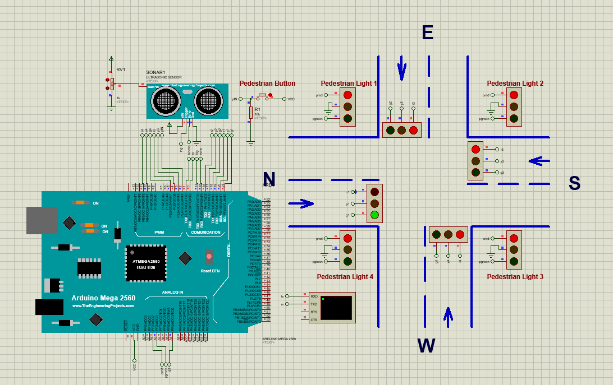
circuit

Slide 8
• G1-R2-R3-R4
• Y1-R2-R3-R4
• R1-G2-R3-R4
• R1-Y2-R3-R4.
• R1-R2-G3-R4
• R1-R2-Y3-R4
• R1-R2-R3-G4
• R1-R2-R3-Y4
i.e., timing-based traffic signal will be automatically implemented when all the signals having same condition.
When Ultrasonic sensor start receiving signal the delay time for green signal of each lane will change accordingly. For distance less than 200 inch delay time is 2 seconds and for distance greater than 200 inch and less than 300 inch delay time is 4 seconds and for greater than 300 it is 6 seconds.

Slide 9
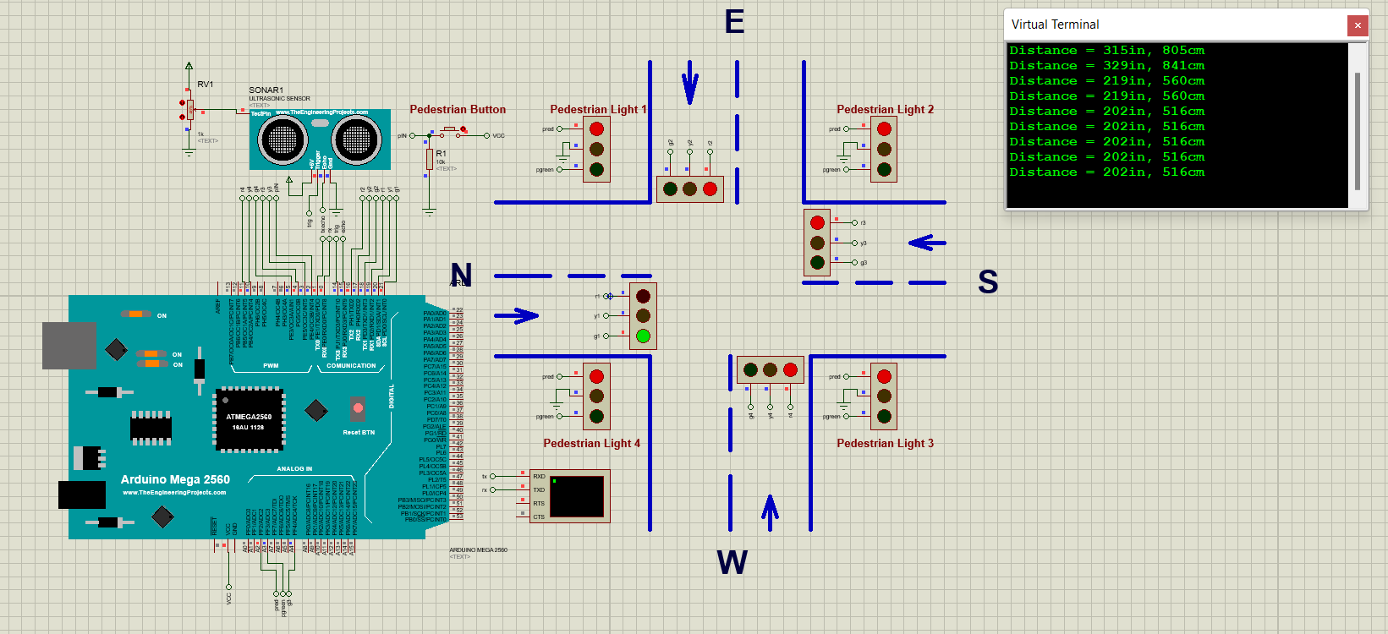

Slide 10
Let green light is On in the fourth traffic signal for 6 seconds and during that time ultrasonic sensor is receiving data of first lane then after green light it will take few seconds delay for yellow light and then first traffic signal green light will be on for the time calculated on the basis of data received from ultrasonic sensor
R1-R2-R3-G4
R1-R2-R3-Y4
G1-R2-R3-R4
Whole time ultrasonic sensor rotates 360 degree and receives data of each lane and Arduino uses that data to change the delay time of each traffic signal accordingly
In between we can turn pedestrian light green and all other red so that people can cross the road.

Slide 11
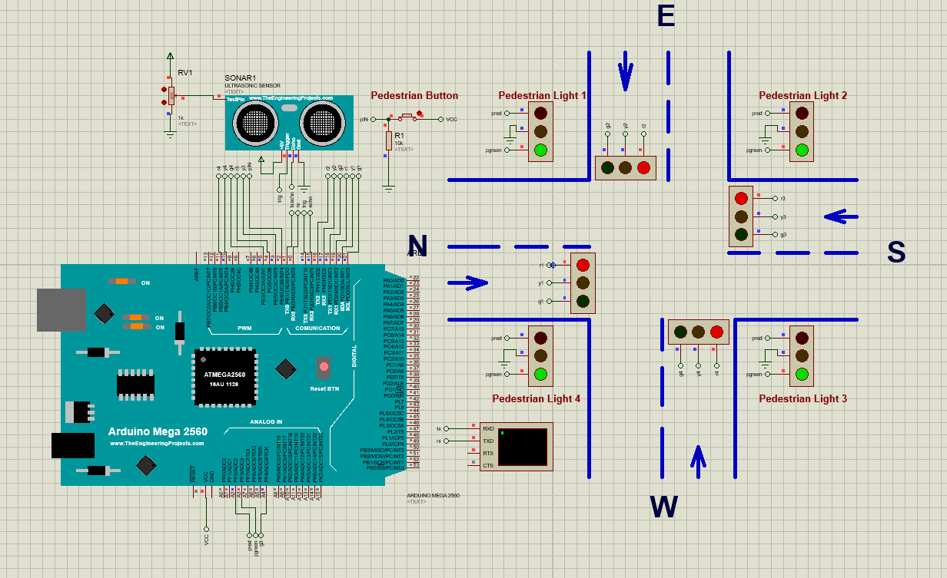
FOR PEdestrian

Slide 12
Result
From the series of experiments we have conducted the following results were obtained:
• Traffic can be cleared without any irregularities
• Time can be shared evenly for all intersections
• Effective time management

Slide 13
Thank you

